Slide 1


Transparency at Scale UNECE recommendation 49 UN Transparency Protocol (UNTP)
Steve Capell
steve.capell@gmail.com
Notes:
Provides advice to governments and industry on practical measures to counter greenwashing by implementing supply chain traceability and transparency at the scale needed to achieve meaningful impacts on global sustainability outcomes.

Slide 2






The motivation for recommendation rec49 (UNTP)
The world faces sustainability challenges
So
Regulators and markets are responding
This starts to provide meaningful incentives for sustainable behaviours
And
But
The same incentives encourage more greenwashing
So
To maintain the value of the incentives we need to combat greenwashing through transparency – at the scale digitisation allows
But
There are a lot of challenges to achieving supply chain transparency at scale – hence recommendation 49
Notes:
Climate change, biodiversity, water consumption, modern slavery
Carbon tariffs, due diligence directive, etc – 16 regs just in EU plus US IRA
80 Euro/ton tariff , market access, access to capital, consumer price uplift
60% of claims have no evidence and 40% are false or misleading – will get worse.
Sunlight is the best auditor – transparency – fair for legitimate traders, un-sustainable behaviour nowhere to hide

Slide 3
Challenge #1 – a plethora of platforms
Depending on your value chain partners to choose the same traceability & transparency platform as you is like saying “I can trade with anyone so long as they have an account at my bank”. It cannot work at scale.

Slide 4








#1 – UNTP is an interoperability protocol, not a platform
Leave data where it is but link it together when needed using decentralised events.
Use any software you like – so long as it conforms to UNTP.
UNTP
UN Traceability Event
shirt
yarn
Product ID
fabric
Batch ID
Location ID
Based on GS1 EPCIS
Traceability Event
cotton
Inspection
Packaging
Shipping
Thousands of platforms, millions of value-chains, billions of transactions
Manufacturing

Slide 5
Challenge #2 – business incentives
Common industry practice today is to use industry averages for up-stream supply chain sustainability performance. But this effectively remove all incentives. Why would an upstream supplier improve product sustainability downstream buyers don’t differentiate?

Slide 6

#2 – The UNTP passport is a bundle of differentiated value
ESG performance can only improve with informed and differentiated supply decisions. DPP claims are categorised for easy IFRS mapping.
UN Digital Product Passport
UNTP
Organisation
There’s a passport for every goods shipment
Facility Data
Product Information
Sustainability disclosures
UN Traceability Event
Provenance Data
Product ID
Batch ID
Sustainability Claims
Location ID
Traceability Event
ESG Metric Value
ESG Performance
Inspection
Links
IFRS topic mapped
Packaging
Item/Batch Data
Shipping
Manufacturing
Traceability Events
Time

Slide 7
Challenge #3 – greenwashing & due-diligence
Greenwashing is already endemic. Differentiated supply decisions will provide even stronger incentives to make false claims. Due diligence regulations may impose liabilities on organisations for false claims from their suppliers. How to add sufficient trust to the system?

Slide 8


#3 – UNTP includes verifiable conformity evidence
Digital product conformity credential - developed in conjunction with national accreditation authorities and conformity assessment bodies.
UN Digital Product Passport
UN Digital Conformity Credential
Organisation
UNTP
Accreditation
Facility Data
Product Information
Scheme or Regulation
Provenance Data
Conformity Attestation
Linked to passport and supports 2nd party, 3rd party, formal, & informal verification
Sustainability Claims
Links
ESG Metric Value
Assessment Body
Item/Batch Data
Conformity Assessment
Traceability Events
Products / Facilities
Secured using W3C Verifiable credential technology
Criteria / Metrics
Assessed values
ILAC MRA aligned

Slide 9
Challenge #4 – commercial confidentiality
Whilst “sunlight is the best auditor”, increased transparency also increases risk of leakage of commercially sensitive information. What one party considers confidential, another may not.

Slide 10
#4 – UNTP includes a privacy & security toolkit
Six tools that allow UNTP implementers to choose their own balance between confidentiality and transparency.
UN Traceability Event
1
UNTP Traceability Events
Product ID
Don’t share what doesn’t provide value
Batch ID
Location ID
UNTP
Traceability Event
2
Inspection
Packaging
Easily share genuinely public data
Shipping
Manufacturing
UN Digital Product Passport
If you’ve got the goods, you can see the data
3
UNTP Product Passports
Organisation
Different data needs different levels of protection.
Apply the right pattern to the right data
Facility Data
Product Information
Provenance Data
4
Sustainability Claims
Anyone that’s been given a secret key can see it
ESG Metric Value
Item/Batch Data
Traceability Events
You need to ask me if you want to see the data
5
UNTP Conformity Credentials
UN Digital Conformity Credential
Accreditation
Scheme or Regulation
Conformity Attestation
6
Assessment Body
Selective redaction – black out what you don’t want to share
Conformity Assessment
Products / Facilities
Criteria / Metrics
Assessed values

Slide 11
Challenge #5 – unequal digital maturity and adoption
UNTP is a digital protocol. If it only worked when every supply chain actor is digitally mature and connected, then nobody would start.

Slide 12


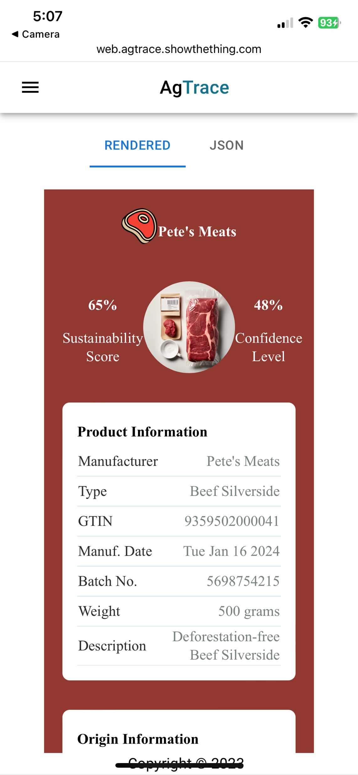
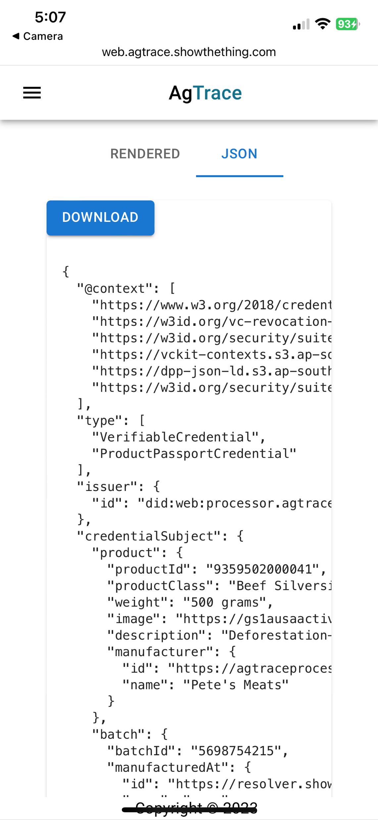


#5 – UNTP allows implementation without dependency
The same UNTP data is always BOTH human and machine readable. So implementers can go digital without dependency on other’s maturity.
UN Traceability Event
UNTP
Human view
Product ID
Batch ID
Rendered from
Location ID
Traceability Event
Inspection
Low volume/ maturity customer
Packaging
Shipping
Manufacturing
Issue human-rendered digital data
UN Digital Product Passport
Organisation
Facility Data
Product Information
Provenance Data
Sustainability Claims
High volume/ maturity customer
ESG Metric Value
Item/Batch Data
Traceability Events
Producer or manufacturer
UN Digital Conformity Credential
Accreditation
Machine view
Scheme or Regulation
Conformity Attestation
Assessment Body
Conformity Assessment
Products / Facilities
Criteria / Metrics
Assessed values

Slide 13
Challenge #6 – compatibility with existing identifiers
Industry uses well established identifier schemes (eg GS1 GTINs) that one actor cannot change without impacting others. Imposing any transparency scheme that requires new product identifiers or registers would present an enormous barrier.

Slide 14



#6 – UNTP leverages existing identifiers and link resolvers
Rich UNTP data is linked-to and discoverable-from existing industry identifiers, even when they are simple 1-D barcodes.
Humans
Product ID register
UN Traceability Event
Product ID
UNTP Traceability Events
Batch ID
Location ID
UNTP
Traceability Event
Inspection
scan
Packaging
Shipping
Manufacturing
Link URL lookup
UN Digital Product Passport
Rich web data
Organisation
UNTP Product Passports
There’s no need to connect system-to-system. Data is always discoverable from the product or batch identifier.
Shipped product
Simple ID
Facility Data
Product Information
Provenance Data
Sustainability Claims
ESG Metric Value
Item/Batch Data
ISO 18975 digital link resolver standard
Traceability Events
scan
UN Digital Conformity Credential
Accreditation
UNTP Conformity Credentials
Scheme or Regulation
Conformity Attestation
Assessment Body
Machines
Conformity Assessment
Products / Facilities
Criteria / Metrics
Assessed values

Slide 15
Challenge #7 – mapping different ESG claims
There are dozens of ESG classification schemes (IFRS, ESRS, GRI, UNEP, etc) and hundreds of ESG standards / specifications, each with multiple criteria. Any given claim in a DPP or assessment in a conformity credential will typically be made against any one of thousands of standard criteria and may (or may not) be classified using any one of dozens of schemes. In this complexity, how can consumers of passport data make any sense of the sustainability claims?

Slide 16
#7 – ESG Vocabulary mapping architecture
UNTP maintains a coarse-grained catalog (using W3C DCAT and SKOS) that maps well established vocabularies so that when any credential maps their claims to any vocabulary then they can be universally understood.
Maintained by UN
UNTP Sustainability Catalog
mapping
mapping
Coarse grained
IFRS
GRI
ESRS
UNEP
Other
Topic 1
Topic 1
Topic 1
Topic 1
Topic 1
Topic 2
Topic 2
Topic 2
Topic 2
Topic 2
Topic n
Topic n
Topic n
Topic n
Topic n
mapping
mapping
Criteria 1
Criteria 1
Criteria 1
Criteria 1
Criteria 1
Criteria 2
Criteria 2
Criteria 2
Criteria 2
Criteria 2
Fine grained
Criteria 3
Criteria 3
Criteria 3
Criteria 3
Criteria 3
Criteria n
Criteria n
Criteria n
Criteria n
Criteria n
PCDS
ISO 14000-x
Fair trade
IRMA
100’s more
Maintained by each standards authority

Slide 17
And there’s more challenges
#8 – Managing identity fraud.
#9 – Counterfeiting
#10 – Mass balance fraud
We’ve thought about these challenges and will add some optional extra tools to UNTP to address them.

Slide 18
Putting it together – what each implementer does.
Issue a DPP for each product you ship and optionally attach conformity credentials and traceability events. Make the data discoverable from the product ID.
Humans
Scan barcode
Scan barcode
Machines
Get passport
Transparency
Traceability
Digital Product Passport
Trust
Organisation
Traceability Event
Digital Conformity Credential
Facility Data
Accreditation
Product ID
Batch ID
Product Information
Scheme or Regulation
Follow links
Provenance Data
Follow links
Location ID
Conformity Attestation
Traceability Event
Sustainability Claims
Assessment Body
Inspection
ESG Metric Value
Conformity Assessment
Packaging
Products / Facilities
Shipping
Item/Batch Data
Criteria / Metrics
Manufacturing
Traceability Events
Assessed values

Slide 19















Puttin it together – entire value chain perspective
Compliance
Ship ore
Ship metals
Ship batteries
Sell new vehicle
Sell used battery
🇦🇺
Authority
Lithium Mine
Processing
Plant
Battery Maker
Car Manufacturer
Consumer
Recycler
Guarantee of origin
Sale Event
Processing event
Manuf-acturing Event
Manuf-acturing Event
EPD
Mining permit
Mineral Passport
Sale Event
Sale Event
Sale Event
Authority
Sale Event
🇨🇦
Authority
Copper Mine
Product Passport
Product Passport
EU DPP
Material passport
Guarantee of origin
EPD
EPD
Battery passport
CBAM tariff
Sale Event
Mining permit
Mineral Passport
Ship materials
B2B due diligence
G2B assessment
Consumer choice

Slide 20
Why UNTP? What about other DPPs?
There are many similar initiatives happening around the world. Some are regulatory mandates, and some have strong industry support. Why should I implement UNTP?
Cross-border upstream focus complements regulatory initiatives
Cross-industry core supports industry sector initiatives.
Complete yet simple solution with a lot of re-usable capability.

Slide 21
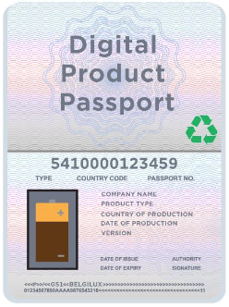


Every regulated market has cross-border supply
UNTP is complementary to regulatory product passports – it provides the high integrity upstream data feedstock to inform regulatory passports.
Upstream traceability and transparency – UN DPP
Market entry & use – eg EU DPP
UNTP
Raw Materials
Processed Materials
Use
Subcomponent Production
Component Production
Assembly
Market placement
Repair Remanufacture Recycle
Organisation
Organisation
Organisation
Organisation
Organisation
Economic Operator
User
Organisation

Slide 22




Every industry needs supply from other sectors
UNTP provides a cross-industry re-usable “core”. Industry can create non-breaking extensions that suit their needs whilst maintaining cross-industry interoperability.
UN Governance
UNTP Extension Methodology
Industry or National Governance
Textile DPP
Textiles Transparency Protocol
Implement
extends
Interoperable
Agriculture DPP
extends
Agricultural Transparency Protocol
Implement
Interoperable
UNTP
extends
Critical Raw Materials Transparency Protocol
Raw materials DPP
Implement
extends
National Transparency Protocol (Country X)
Interoperable
Implement
Country X
DPP

Slide 23



A complete solution and simpler than you think
Other standards may include some useful parts – but leave you to assemble them.
UNTP is a complete standard designed to address all the challenges you will face.
UNTP
There is some new-ish technology involved (e.g. verifiable credentials) but it solves real problems and is simple to implement (e.g. 9 lines of code in the Australian pilot)

Slide 24
UNTP - Winning the race to the top
There is already a significant difference between consumer expectation and market behaviour. There are two plausible pathways out of this:
Either : A race to the top
Greenwashing is rare and has nowhere to hide
Or : A race to the bottom
Greenwashing is ubiquitous and undetectable
2. Consumer confidence improves
1. It’s easy to fake claims
4. Even well-intentioned businesses must fake claims to survive.
1. It’s hard to fake claims
3. Higher prices are justified
2. Consumer confidence drops
3. Low confidence means no price differential
4. Businesses compete on quality of claims
UNTP – winning the race to the top

Slide 25
UNTP – timeline for protocol development & pilots
June 2023
Dec 2023
Today
July 2024
Dec 2024
UNECE Recommendation 49
Draft Policy
Public Review
Implementation Pledges
UNTP Specification
Discovery
v0.1+ PoCs
Alpha
V0.5+ Pilots
Beta
V1.0 Scaling up
Ongoing Governance
Vx.y
Agriculture Pilots – Australia, EU
Red Meat PoC
Red Meat, Horticulture & Grains Pilot
Adoption at scale
Critical Minerals Pilots - Canada, Australia, Democratic Republic of Congo
CA Copper PoC
CA Copper, AU Lithium, DRC Cobalt Pilots
Scale up
Your Industry / Jurisdiction Pilots?
Proof of concept
Low volume pilots
Scale up

Slide 26





















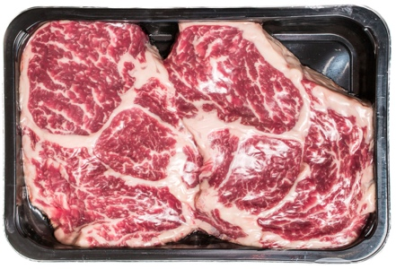

Try it yourself – the Australian Agriculture UNTP pilot
Sell herd
Sell fatter herd
Sell beef product
Sell grain
Take out your phones and scan this QR to get the sample link resolver app.
Certifier
Cattle farm
Grain farm
Saleyard
Feedlot
Processor
DAFF
EU Importer
Wagyu Wonder
Golden Grains
Fabulous Feeders
Pete’s Meats
Then scan this GTIN barcode on the meat product and follow the linked data trail
Deforestation Credential
(cattle farm)
Movement Event
Feeding Event
Processing Event
6
Sale Event
Deforestation Credential
(grain farm)
5
4
Livestock Passport
Sale Event
Sale Event
1
7
Grain Passport
3
2
Livestock Passport
Product Passport
You!

Slide 27
Transparency at Scale UNECE recommendation 49
Steve Capell
steve.capell@gmail.com
https://uncefact.github.io/spec-untp/

